Slide 1
TCP Flags
TCP flags are used to indicate a particular state during a TCP conversation
  URG (Urgent)
  ACK (Acknowledgment)
  PSH (Push)
  RST (Reset)
  SYN (Synchronize)
  FIN (Finish)
  Each TCP flag corresponds to 1 bit in size
Three way - Handshake

Slide 2
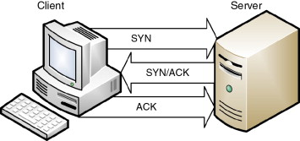
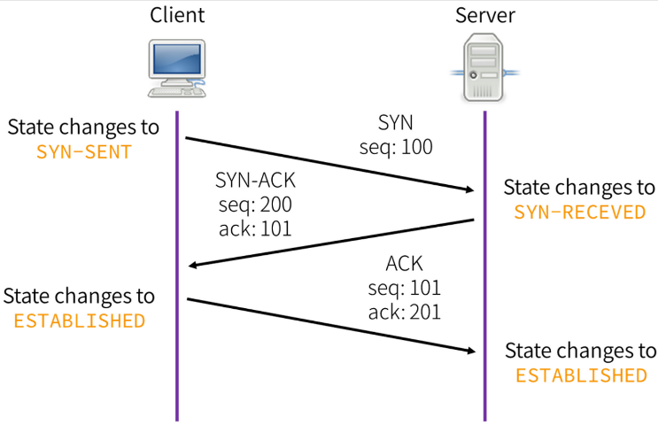
TCP 3-Way Handshake
Step 1: The client sends a segment with SYN flag informs wants to connect to the server
Step 2: The server responds to the client request with SYN-ACK signal bits set
Step 3: The client sends a segment with an ACK flag that acknowledges the response and will begin the actual data transfer process
Three way - Handshake

Slide 3
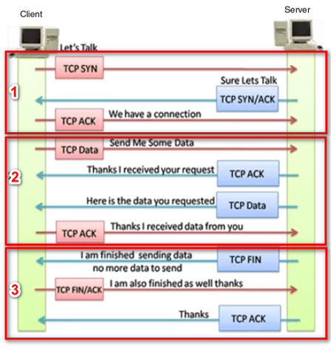
TCP Data Transmission Process
Step 1: Establish connection
Step 2: Send packets of data
Step 3: Close the connection
Three way - Handshake

Slide 4
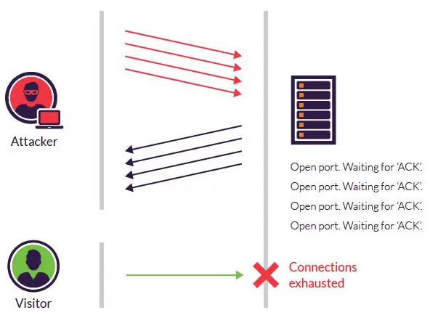
TCP SYN Flood Attack
TCP SYN flood is a type of Distributed Denial of Service (DDoS) that exploits part the TCP 3-way handshake
In a SYN flood attack, the attacker sends repeated SYN packets to every port on the targeted server
The server cannot connect to any clients
Three way - Handshake

